Slide 1
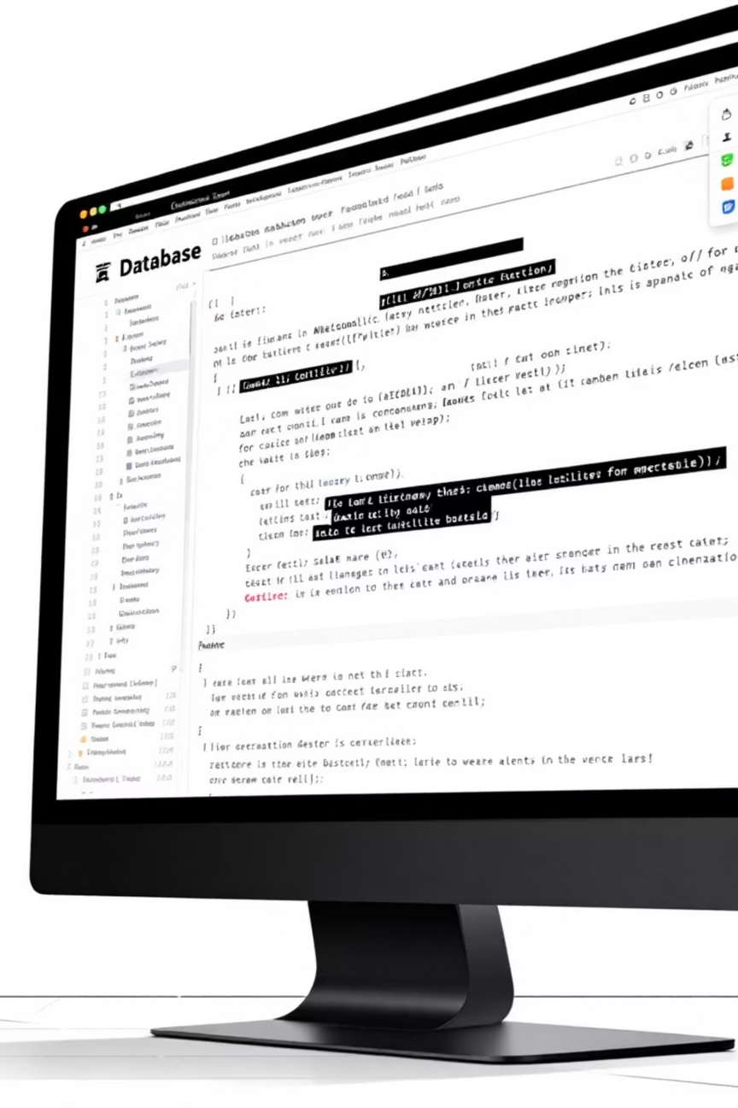

Building a Complete e-Commerce Database with SQL
A practical guide to designing, populating, and querying a robust database for an online shopping platform. Learn how to structure tables, enforce data integrity, and extract meaningful insights from your data.
Notes:
1

Slide 2

Database Architecture Overview
The shopdb database consists of four interconnected tables that model a complete e-commerce system. Each table serves a distinct purpose whilst maintaining referential integrity through foreign keys.
Customers
Store customer contact details, including email and phone verification to prevent duplicates.
Products
Manage inventory across categories, enforcing price and stock constraints at the database level.
Employees
Track staff information, roles, and compensation with salary validation.
Orders
Record transactions with status tracking and relationships to customers and products.
Notes:
2

Slide 3

Chapter 1: Database Setup
Creating the Foundation
Begin by creating the shopdb database and establishing the customers table. Use AUTO_INCREMENT for primary keys and UNIQUE constraints on email and phone to prevent duplicate entries. Set created_at with a default timestamp to track customer registration dates automatically.
Notes:
3

Slide 4

Table Structure and Constraints
Define products with category classification and check constraints ensuring prices remain positive and stock levels non-negative. Employees require hire dates and validated salary information. Orders must reference valid customers and products, with status restricted to four valid states: Pending, Shipped, Delivered, or Cancelled.
Key Constraints Applied
Best Practices Demonstrated
Primary keys for unique identification
Enforce business rules at database level
Foreign keys linking orders to customers and products
Use meaningful column names
Default values for automatic timestamps
Check constraints for valid data ranges
Descriptive check constraints on statuses
Unique constraints preventing duplicates
Notes:
4

Slide 5

Chapter 2: Data Population
Inserting Sample Data
Populate the database with realistic sample data across all tables. The dataset includes 30 customers from various Indian cities, 30 diverse products across five categories, 30 employees in different roles with varying salaries, and 30 orders tracking the complete transaction lifecycle. This volume provides sufficient data for meaningful analytical queries.
30
30
30
30
Customers
Products
Employees
Orders
Registered across India
Five categories
Various roles
Transaction records
Notes:
5

Slide 6
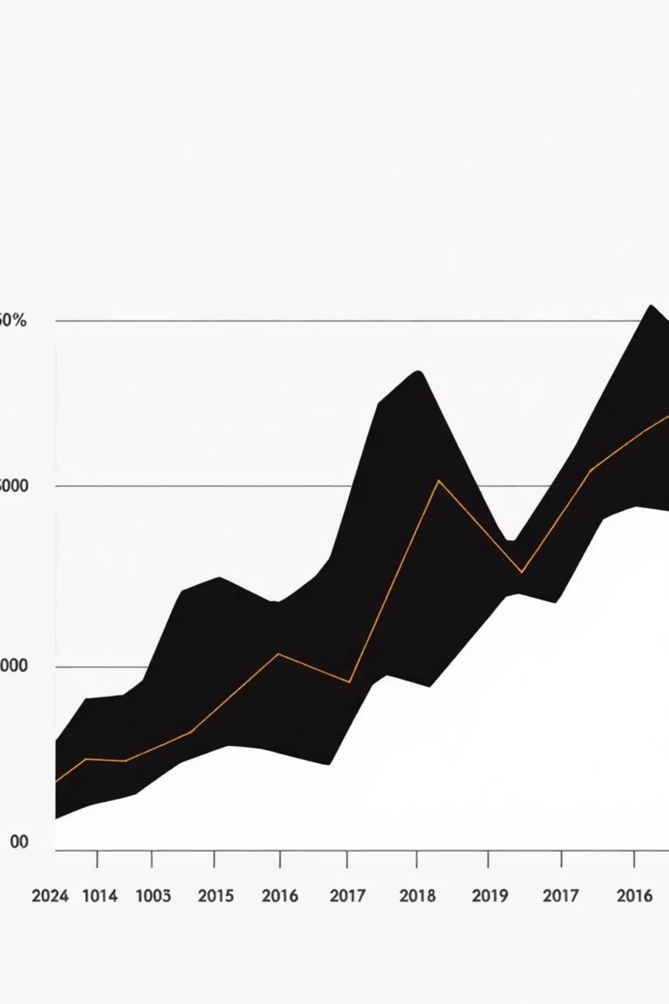
Query 1: Monthly Order Trends
Group orders by month using the MONTH() function and count occurrences to identify seasonal patterns. This reveals which months generated the most transactions, helping forecast inventory needs and plan marketing campaigns accordingly.
SELECT MONTH(order_date) AS order_month, COUNT(*) AS totalFROM orders GROUP BY MONTH(order_date);
Notes:
6

Slide 7

Query 2: Customer Timeline Analysis
Identify the earliest order for each customer using GROUP BY customers_id combined with MIN(order_date). This determines which customers have been most loyal and when they made their first purchase, enabling targeted retention strategies.
SELECT customers_id, MIN(order_date) AS first_purchaseFROM orders GROUP BY customers_id ORDER BY customers_id;
Business Insight
Track customer acquisition timeline to measure retention rates and lifetime value.
Notes:
7

Slide 8
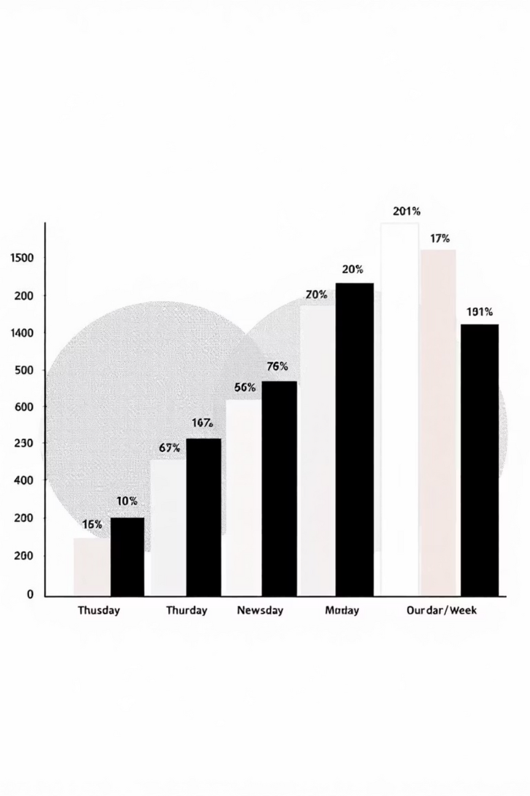
Query 3: Order Distribution by Day
Use DAYNAME(order_date) to extract the day of the week and ORDER BY to identify peak shopping days. Discover whether customers prefer weekday or weekend ordering, allowing you to optimise staffing and delivery schedules accordingly.
SELECT DAYNAME(order_date) AS day_of_week, COUNT(*) AS total_ordersFROM orders GROUP BY DAYNAME(order_date) ORDER BY total_orders DESC;
Notes:
8

Slide 9


Query 4: Inventory Management Alert
Identify products with zero stock or below-average inventory levels using a subquery to calculate average stock. This critical query prevents stockouts by highlighting items requiring immediate reordering and revealing which products underperform against category benchmarks.
SELECT prodcut_id, name, category, price, stockFROM products WHERE stock = 0 OR stock < (SELECT AVG(stock) FROM products);
Zero Stock Items
Immediate action required for reordering
Below-Average Stock
Monitor closely and plan procurement
Notes:
9

Slide 10

Key Takeaways for Your Projects
1
Enforce Constraints Early
Use check constraints, unique constraints, and foreign keys to maintain data integrity at the database level rather than relying on application code.
2
Master Aggregation Functions
Combine GROUP BY with COUNT(), MIN(), MAX(), and date functions to extract actionable business insights from raw data.
3
Leverage Subqueries for Complex Logic
Use subqueries in WHERE clauses to perform dynamic comparisons like identifying products below average stock levels.
4
Design for Scale
Structure your schema with proper relationships from the start to support future growth and complex analytical queries.
Notes:
10

